Slide 1
Computer‑aided detection
of arrhythmogenic sites
in post‑ischemic ventricular tachycardia
28 May 2024
Andrea Corrado

Slide 2
Background
Ventricular tachycardia (VT) is a ventricular arrhythmia caused by structural ischemic or non-ischemic heart diseases.
Trans-catheter ablation is an effective option for different forms of VT, however, requires more than one procedure to be completed.
Currently the procedure require the identification of abnormal ventricular potentials (AVPs) by clinicians during electrophysiological studies and manually tagged on the electroanatomic (EA) maps to perform the ablation. That leads electrophysiological procedures to be a complicated and significantly time-consuming process, and their outcomes are highly dependent on the operators’ expertise.
Several existing researches demonstrated the effectiveness of using parameters extracted from EGMs to define critical areas related to VT. These studies clearly indicated the possibility of defining cut-off ranges for highlighting VT critical sites, with sensitivities and accuracies ranging from 65 to 100% in detecting ablation areas, fractionated signals, VT sites of origin or VT isthmuses, or proving statistically significant differences between control groups and VT patients.
The aim of this work was investigating the adoption of AI tools for the identification of arrhythmogenic sites in VT mapping procedures, based on the study of conventional and unconventional features belonging to time, time scale, frequency, and spatial domains.

Slide 3
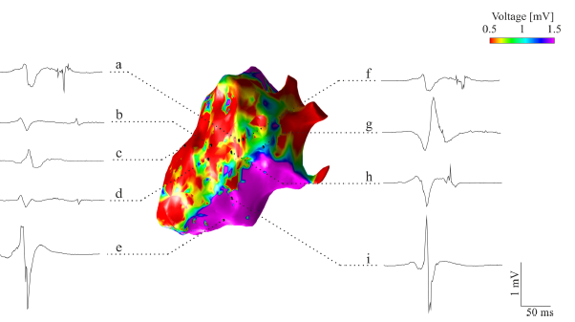
Material and methods [1/3]
Dataset (retrospective study)
9 patients (78% male, age: 66±10 years old) with post-ischemic VT.
EMG acquisition protocol:
Data acquired with CARTO 3 system on the sinus rhythm during Left ventricle (LV) EA mapping
2.5 sec of acquisition with 1kHz sampling frequency and band-pass filtering between 16 and 500 Hz
Manual (blind to the EMG localization) annotation of the segments as physiological or AVPs
1584 Records, 618 AVPs and 966 physiological (unbalance toward physiological class)

Slide 4
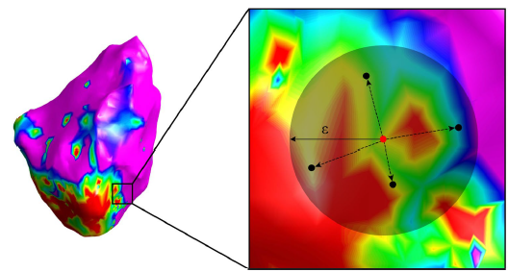
Material and methods [2/3]
Feature identification and selection
Four type of feature were build using row data:
Time domain: peak-to-peak amplitude, fragmentation
Time-scale domain (after wavelet transformation): sum and standard deviation of average powers associated with the most powerful scales
Frequency domain (after PSD computation): Relative power between 0 and 320Hz (20Hz sub-bands), mean frequency, mean spectral power, power-spectrum ratio
Spatial domain (neighboring procedure needed on maps): mean bipolar voltage, weighted MBV, standard deviation of the local peak-to-peak amplitude, normalized number of neighbors, local activation time (LAT), conduction velocity.
Features was selected using minimum redundancy maximum relevance (mRMR) method leading to a final number of features of 16 (original: 32)

Slide 5
Material and methods [3/3]
Models and training strategies
Three models were used:
SVM (third order polynomial kernel)
KNN (10 neighbors)
Ensemble tree (ENS)
And all of them were:
Trained with two sets of features:
Whole feature set
Features selected using minimum redundancy maximum relevance (mRMR) method leading to a final number of features of 16 (original: 32)
Trained and tested with two strategies:
10 –time-10-folds cross validation
Leave-one-out cross validation

Slide 6
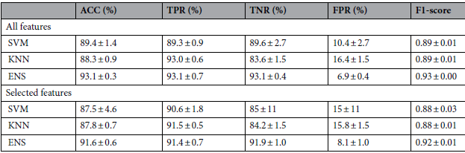
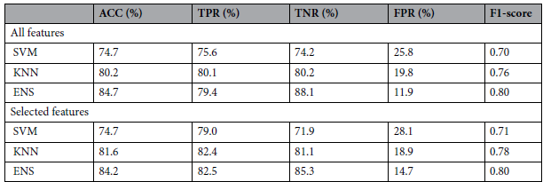
Results
10-time-10-fold cross validation
Leave-one-out cross validation

Slide 7
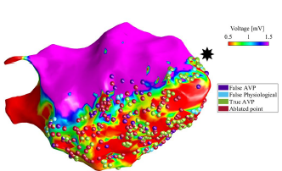
Conclusions
The presented work demonstrated the feasibility of supervised machine learning tools for the identification of arrhythmogenic sites in post-ischemic VT patients
High recognition capabilities are observable even when a leave-one-subject-out validation scheme is applied, which is closer to a real application scenario, albeit with a performance deterioration, particularly in terms of accuracy and TPR.
The study has two main limitations: the dataset size and the single-expert annotation, which could have biased the results

